Slide 1
EVN
HyperLogistics
EVN delivers safety-compliant, explainable AI rerouting for middle-mile logistics.
2026 Regnier Venture Creation Challenge
7.7M
100%
+55 pts
17/17
Accident Records
Safety Compliance
Accuracy Lift
Repro Tests Pass
Joel Vinas • Daniel Evans • Tony Nguyen

Slide 2
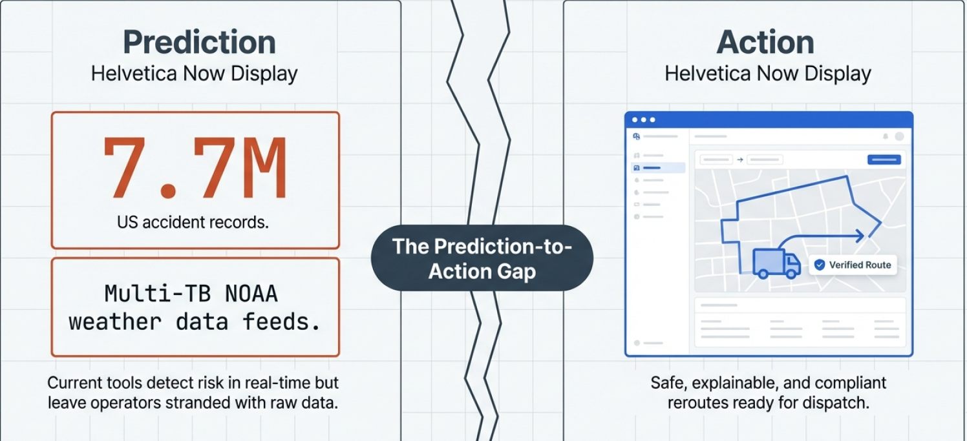
01 The Problem
Safety-Compliant • Explainable AI • Middle-Mile
Middle-mile teams face immense pressure during disruptions. Without trustworthy AI, prediction cannot safely cross the gap into action
EVN HyperLogistics | 2026 RVCC
Notes:
Disruptions are constant, but current tools do not bridge prediction to safe action.
Dispatchers need both speed and explainability during weather and accident events.
The gap is not just forecasting — it is compliance-aware decision execution.

Slide 3
02 Our Solution
Safety-Compliant • Explainable AI • Middle-Mile
HyperLogistics combines forecasting, retrieval, and hard safety veto into one decision flow.
1
2
3
RETRIEVE
FORECAST
SAFETY VETO
ReMindRAG retrieves grounded evidence for route reasoning — no free-form generation.
SRSNet predicts disruption propagation over 4–8 hour middle-mile transit windows.
Symbolic bridge-constraint veto blocks unsafe recommendations before dispatch.
Safety layer enforces 100% PHYSICAL CONSTRAINT COMPLIANCE through bridge clearance and load checks
EVN HyperLogistics | 2026 RVCC

Slide 4
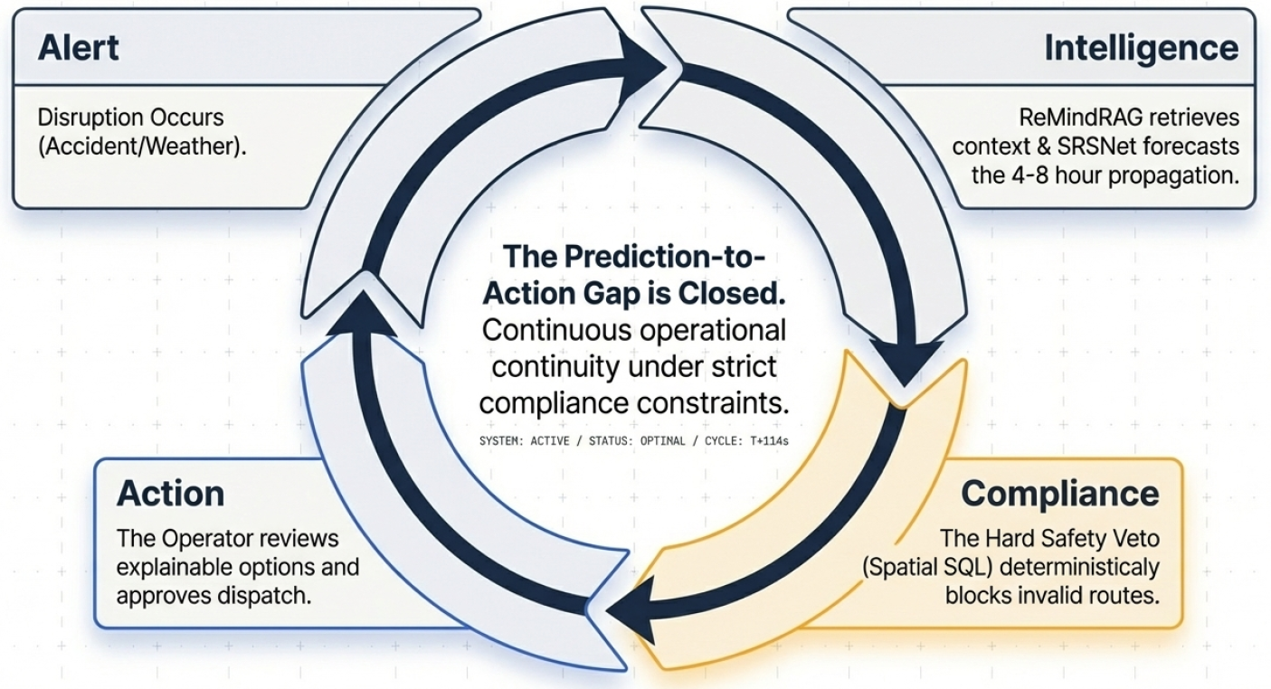
02 Our Solution
Safety-Compliant • Explainable AI • Middle-Mile
HyperLogistics combines forecasting, retrieval, and hard safety veto into one decision flow.
EVN HyperLogistics | 2026 RVCC
Notes:
Disruptions are constant, but current tools do not bridge prediction to safe action.
Dispatchers need both speed and explainability during weather and accident events.
The gap is not just forecasting — it is compliance-aware decision execution.

Slide 5
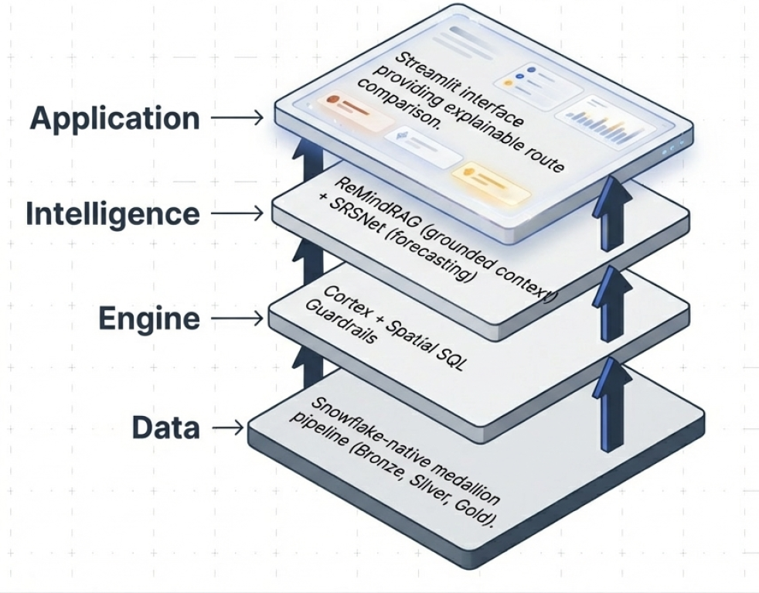
03 Product & Technology
Safety-Compliant • Explainable AI • Middle-Mile
Snowflake-native architecture operationalizes explainable rerouting in production form.
Medallion data pipeline (Bronze/Silver/Gold) supports ingestion, preprocessing, and serving.
Core stack: ReMindRAG + SRSNet + Snowflake Cortex + Spatial SQL guardrails.
Forecasting configured for 4-8 hour middle-mile transit windows.
Streamlit app surfaces risk heatmaps, side-by-side route options, and rationale.
EVN HyperLogistics | 2026 RVCC

Slide 6
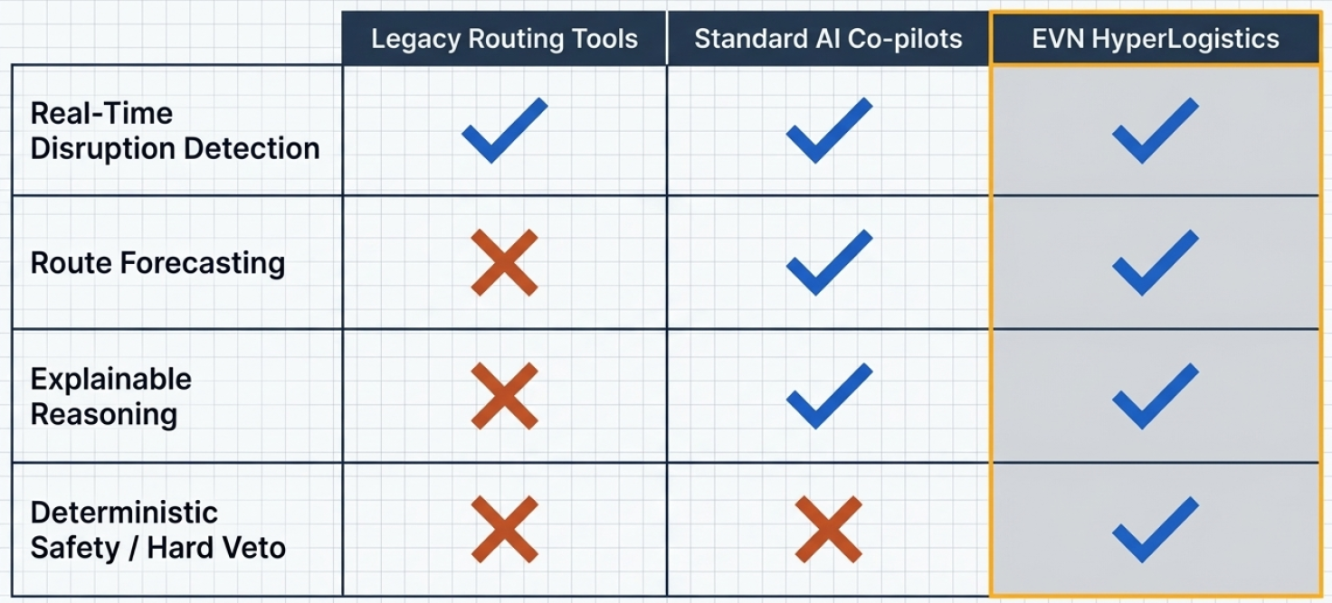
03 Product & Technology
Safety-Compliant • Explainable AI • Middle-Mile
Only EVN Hyperlogstics possesses the Deterministic Safety Veto required to make AI outputs physically and legally viable for freight
EVN HyperLogistics | 2026 RVCC

Slide 7
04 Target Customer
Safety-Compliant • Explainable AI • Middle-Mile
Built for middle-mile decision owners at carriers and 3PLs.
L
A
Logistics Network Manager
Area Manager
Strategic Route Owner
Operational Executor
Disruption triage
Reroute approval
Network-wide compliance
Cost control under pressure
On-time performance
Local route execution
Driver safety oversight
Compliance confirmation
Week 8: 100 Area Manager query-response pairs trained and validated on operational language
EVN HyperLogistics | 2026 RVCC

Slide 8
05 Market Opportunity
Safety-Compliant • Explainable AI • Middle-Mile
A $110B market growing toward $218B — underserved by compliance-aware AI.
TAM
Middle-Mile Logistics
SAM
Route Optimization Software
SOM
Explainable AI in Logistics
$110B
$7.9B
$1.7B
Global Market (2025)
Global Market (2025)
Generative AI Logistics (2025)
7% CAGR → $218B by 2035
13.3% CAGR → $16.8B by 2031
33.7% CAGR → $31.7B by 2035
All carriers, 3PLs, and freight operators managing hub-to-hub and distribution-center routing decisions globally.
Carriers and 3PLs actively purchasing route intelligence software — the direct buyer segment for explainable AI rerouting.
Early-stage but fastest growing segment: AI systems that explain decisions and enforce hard compliance — EVN's exact position.
Source: ResearchAndMarkets / 360iResearch
Source: Mordor Intelligence
Source: Future Market Insights
EVN targets the SAM/SOM intersection: compliance-enforcing, explainable AI for active freight operations.
EVN HyperLogistics | 2026 RVCC

Slide 9
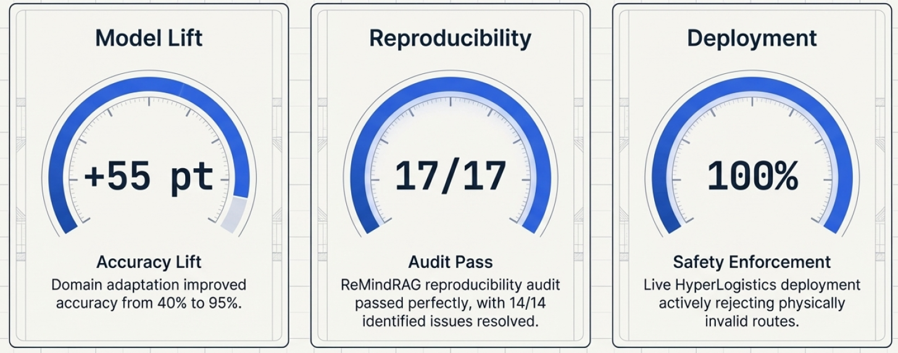
06 Progress & Traction
Safety-Compliant • Explainable AI • Middle-Mile
Working deployment evidence, measurable lift, and reproducible execution.
Lift
dit
Eval Quality
Adaptation Proof
Eval Quality
Live Deployment
17/17 automated tests pass, 14/14 issues closed — ReMindRAG reproducibility audit.
Domain-adapted model: 40% baseline → 95% evaluation metrics.
17/17 automated tests pass, 14/14 issues closed — ReMindRAG reproducibility audit.
HyperLogistics Streamlit app deployed and available — not a notebook demo.
EVN HyperLogistics | 2026 RVCC

Slide 10
07 Business Model
Safety-Compliant • Explainable AI • Middle-Mile
Enterprise SaaS licensing with implementation and analytics expansion.
MOST POPULAR
$
$$
$$$
CORE PLATFORM
ENTERPRISE INTEGRATION
ADVANCED ANALYTICS
Annual License
Implementation Services
Premium Modules
Explainable rerouting intelligence
Hard safety-compliance guardrails
Streamlit dispatcher interface
Snowflake-native deployment
Snowflake data onboarding
Workflow and ERP integration
Custom training on fleet data
Dedicated onboarding support
9-tool multi-agent analytics
Route profitability analysis
Safety & maintenance insights
Fuel optimization reporting
Land-and-Expand Model • 9-Tool Multi-Agent Analytics from Week 6 Prototype
EVN HyperLogistics | 2026 RVCC

Slide 11
08 Our Team
Safety-Compliant • Explainable AI • Middle-Mile
EVN combines data engineering, modeling, and product delivery ownership.
JV
DE
TN
Joel Vinas
Daniel Evans
Tony Nguyen
Internal data engineering
Ingestion pipelines
Preprocessing architecture
External weather integration
App delivery & UI
Evaluation support
Automation architecture
S3/Snowflake orchestration
Reproducibility controls
Bronze/Silver/Gold Medallion Pipeline
Streamlit App + NOAA Integration
ReMindRAG Repro Audit 17/17
Balanced contribution: 33.3% each • Full-stack coverage: Ingestion to Deployment to Compliance
EVN HyperLogistics | 2026 RVCC

Slide 12
09 Next Steps & Vision
Safety-Compliant • Explainable AI • Middle-Mile
Complete evaluation hardening, enterprise controls, and rollout scaling.
PHASE 1
HARDENING
PHASE 2
ENTERPRISE
PHASE 3
ROLLOUT
Finalize metamorphic eval
Lock benchmark reporting
Close all test items
15 queries + 5 metamorphic pairs
Scale beyond 100 examples
OAuth + RBAC controls
Enterprise workflow fit
Expand deployment footprint
Production fleet onboarding
Broaden carrier partnerships
EVN as default rerouting layer
Middle-mile industry standard
1
2
3
Vision: EVN as the default explainable rerouting layer for middle-mile operations where safety and trust are non-negotiable.
EVN HyperLogistics | 2026 RVCC

